Slide 1
Personal Health Information Act
Nova Scotia
Department of Health and Wellness

Slide 2
  DISCLAIMER
  This presentation has been prepared by the Nova Scotia Department of Health and Wellness to assist custodians in understanding their roles and responsibilities under the Personal Health Information Act (PHIA).
  The content is the interpretation of the Department of Health and Wellness, and it is not intended to constitute legal advice.

Slide 3
  Presentation Overview
  What is PHIA?
  Purpose, scope and application of PHIA
  What does it mean to be a custodian under PHIA?
  Consent
  Planning and management of the health system
  Research
  Offences and Penalties
  Additional highlights of PHIA
  PHIA Implementation
  Next steps

Slide 4
What is PHIA?
The Personal Health Information Act
Provincial legislation under the Nova Scotia Department of Health and Wellness
Passed in 2010 (Bill 89); amended in 2012 (Bill 76)
PHIA proclaimed and regulations approved in December 2012
PHIA came into force on June 1, 2013

Slide 5
What is PHIA?
Aims to achieve a balance between an individual’s right to privacy and the benefits of use of personal health information
Includes provisions for:
  collection, use, disclosure, destruction and disposal of personal health information
  consent
  information practices
  access and correction
  complaints
  reviews

Slide 6
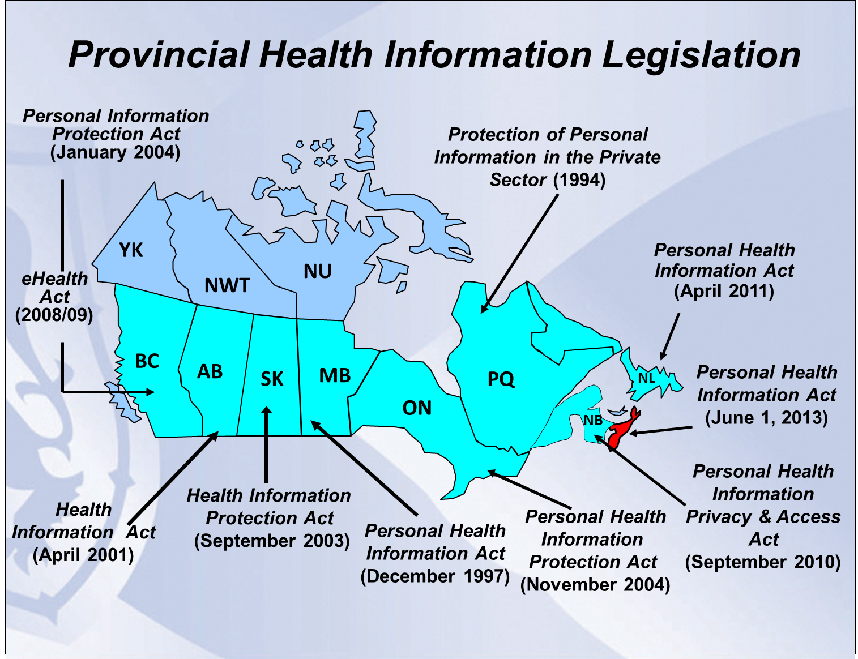
Federal
PIPEDA
Privacy Act

Slide 7
PHIA: Purpose
“ …to govern the collection, use, disclosure, retention, disposal and destruction of personal health information in a manner that recognizes both the right of individuals to protect their personal health information and the need of custodians to collect, use and disclose personal health information to provide, support and manage health care.”
PHIA s.2

Slide 8
PHIA: Scope
PHIA applies to:
    “custodians”
    “personal health information”
    “health care”

Slide 9
Scope – who is covered?
“Custodians”
List of custodians is contained in PHIA
Department of Health and Wellness
District Health Authorities & IWK Health Centre
Regulated health professionals
Others by regulation

Slide 10
Scope – who is covered?
“Custodians”
Custodians must have “custody or control” of the personal health information
PHIA also applies to “agents” of custodians
  Example: employees, volunteers, regulated health professionals with privileges, vendors

Slide 11
What does it mean to be a “custodian”?
A custodian is accountable for the personal health information that it collects, uses and discloses for the provision of health care
A custodian has a legal obligation to protect personal health information within the requirements of PHIA

Slide 12
What does it mean to be a “custodian”?
A custodian must have a contact person for PHIA to provide information on the rights of the individual
A custodian must consider requests for access to and correction of an individual’s personal health information
A custodian must implement and maintain a complaints policy

Slide 13
What does it mean to be a “custodian”?
A custodian must prepare and make readily available a notice of purposes, which outlines the use and disclosure of an individual’s personal health information
A custodian must prepare and make available a written privacy statement outlining the custodian’s information practices, how to reach the contact person, how to make an access or correction request, and how to make a complaint

Slide 14
What does it mean to be a “custodian”?
A custodian must have the ability to create and maintain a record of user activity for any electronic information system it uses to hold personal health information

Slide 15
Scope – what is covered?
Applies to “personal health information” which means “identifying information about an individual, whether living or deceased…”
“Identifying information” means “information that identifies an individual or, where it is reasonably foreseeable in the circumstances, could be utilized, either alone or with other information, to identify an individual”
PHIA s. 3 (f), 3(l)

Slide 16
Scope – what is not covered?
Does not apply to:
  statistical information
  aggregate information
  de-identified information
Also does not apply to information related to a provider (e.g. prescribing history)

Slide 17
Scope – Health Care
“Health Care” - an observation, examination, assessment, care, service or procedure in relation to an individual that is carried out, provided or undertaken for one or more of the following health related purposes:
  the diagnosis, treatment or maintenance of an individual's physical or mental condition,
  the prevention of disease or injury,
  the promotion and protection of health,

Slide 18
Scope – Health Care
  palliative care,
  the compounding, dispensing or selling of a drug, health-care aid, device, product, equipment or other item to an individual or for the use of an individual, under a prescription, or
  a program or service designated as a health-care service in the regulations
  (e.g. Adult Protection assessments)
  PHIA s. 3(k)

Slide 19
Consent Models Under PHIA
Express consent
  oral or written
Knowledgeable implied consent
  used only within circle of care
Without consent
  covered in sections 31 (collection), 35 (use) and 38 (disclosure)
  custodian may collect, use and disclose without consent, but may also choose to seek consent

Slide 20
Consent Standards Under PHIA
Consent must:
be given by the individual or the individual’s substitute decision maker;
be knowledgeable;
be specific to the information at issue; and
be voluntary
PHIA s. 13

Slide 21
Express Consent
Express consent is required for collection and use for:
  fund-raising activities
  market research or marketing any service for a commercial purpose

Slide 22
Express Consent
Express consent is required for disclosure:
  from a custodian to a non-custodian*
  from a custodian to another custodian for a non-health care purpose
  fund-raising activities
  market research or marketing any service for a commercial purpose
  to the media
  person or organization for research (s. 57)
*unless required or authorized by law

Slide 23
Knowledgeable Implied Consent
  “Unless this Act requires express consent or makes exception to the requirement for consent, knowledgeable implied consent may be accepted as consent for the collection, use and disclosure of personal health information.” (PHIA s. 12)
  Knowledgeable implied consent is the basis for exchange of information between custodians within the “circle of care”

Slide 24
“Circle of Care”
The term “circle of care” is not used in PHIA
Circle of care is a term commonly used to describe the ability of certain health information custodians to assume an individual’s knowledgeable implied consent to collect, use or disclose personal health information for the purpose of providing health care
Knowledgeable implied consent must still meet consent standards
(Source: Circle of Care, Sharing Personal Health Information for Health Care Purposes, IPC Ontario,2009)

Slide 25
District Health Authority
Knowledgeable
implied
consent
Circle of Care
Nurses
Volunteers
Physician (GP)
Physiotherapist
(private)
EXPRESS CONSENT
EXPRESS CONSENT
Health
Records
Dietician
Physicians
Lab techs
Exceptions
DHW initiative
Patient invokes s. 17

Slide 26
Limitation & Withdrawal of Consent
A patient may limit or revoke consent and custodians must take “reasonable steps to comply” with the request after receiving notice from the patient (s. 17)
  “consent directives” and “masking” are terms used to describe the patient’s ability to limit or withdraw consent
  These terms do not appear in PHIA

Slide 27
Planning and Management of the Health System
PHIA permits custodians to disclose to Department of Health and Wellness and permits the Department of Health and Wellness to collect information without consent for planning and management of the health care system
Authority to plan and manage the healthcare system is limited to the Department of Health and Wellness

Slide 28
Planning and Management of the Health System
However, any custodian may use personal health information without an individual’s consent for planning and delivering programs or services that the custodian provides or funds, allocating resources to any of them and monitoring or evaluating any of them
PHIA s. 35(1)(a)

Slide 29
Research
Rules for use of personal health information by custodian for research purposes include:
  development of a research plan
  Research Ethics Board approval
  prior to commencement of research meets conditions of Research Ethics Board
  research plan must address consent & specifically where consent is not being sought, an explanation as to why seeking consent is “impracticable”
Requirements regarding the use of information for research are new requirements for custodians
Notes:
"impracticable" means a degree of difficulty higher than inconvenience or impracticality but lower than impossibility;

Slide 30
Research
A custodian may disclose personal health information for research without consent if:
  An Research Ethics Board has determined that the consent of the individual is not required; and
  The custodian is satisfied that:
    the research cannot be conducted without using personal health information;
    the personal health information is limited to the information necessary to accomplish the purpose of the research;
    the personal health information is in the most de-identified form possible;
    Continued…

Slide 31
Research
  The custodian is satisfied that:
    the personal health information will be used in a manner that ensures its confidentiality;
    it is impracticable to obtain consent; and
    the custodian informs the provincial Review Officer

Slide 32
Offences and Penalties
The legislation includes penalties for offences under the Act
Offences include collecting, using or disclosing personal health information in contravention of the Act or regulations; willfully altering or destroying records; and obstructing the Review Officer
Penalty for an individual: a fine of not more than $10,000 or imprisonment for six months, or both
Penalty for a corporation: a fine of not more than $50,000

Slide 33
Additional Highlights
Custodians shall limit the collection, use and disclosure of personal health information to what is required to meet the need and only allow access to the information that employees, vendors etc. “need to know” to do their job
Notes:
.

Slide 34
Additional Highlights
Restrictions on who can collect health card number
Only custodians or those authorized by regulation are permitted to collect the health card number

Slide 35
Additional Highlights
  Custodians shall have retention schedules and ensure they are followed
  Retention schedules apply to personal health information in paper and electronic form

Slide 36
Additional Highlights
Independent privacy oversight is required under PHIA
Privacy oversight authority lies in Privacy Review Officer Act
The provincial Review Officer can conduct reviews or initiate investigations
The provincial Review Officer has recommendation-making power

Slide 37
Additional Highlights
Requirement to report to an individual any breach of their personal health information where there is potential for harm or embarrassment
Custodians are required to notify the Review Officer in cases where they do not report the breach to the individual
Notes:
We will be working on criteria and rationale to assist custodians in making decisions about harm.

Slide 38
Additional Highlights
PHIA protects documents subject to solicitor-client privilege
The provincial Review Officer cannot compel production of records to determine if the claim of solicitor-client privilege is valid
Notes:
.

Slide 39
Implementation: Regulations
Regulations approved in December 2012
Regulations include:
  definitions (e.g. electronic health record)
  designating a program or service as a health care service (e.g. Adult Protection assessments)
  authorizing specific non-custodians to collect health card number (e.g. schools collect for facilitating emergency care for students)
  maximum fees permitted to be charged by a custodian to an individual requesting to view or have a copy of his/her own record

Slide 40
Implementation: Communications
Communications and education tools include:
  Toolkit for custodians (including templates)
  PHIA website
  FAQs
  Toll-free inquiry line and PHIA e-mail
  Educational videos
  DHW fact sheet/poster on PHIA
  Standard presentation on PHIA

Slide 41
Implementation:
Toolkit for Custodians
To support custodians with their understanding of their obligations under PHIA
General reference, best practices and templates:
  Complying with PHIA
  PHIA and PIPEDA
  Duties of a Custodian
  Consent, Capacity and Substitute Decision-Making
  Collection, Use and Disclosure
  Access to and Correction of Personal Health Information
  Research
  Electronic Health Record/Electronic Information Systems
  Complaints under PHIA
  The Review Officer, Reviews and Mediation
  Offences and Penalties

Slide 42
Next Steps
Further information on the Personal Health Information Act is available on the Department of Health and Wellness PHIA website
DHW – Privacy and Access Office will continue to work with custodians to ensure they are ready for PHIA

Slide 43
  Toll-free inquiry line
  1-855-640-4765 or 424-5419
  Website
  www.novascotia.ca /DHW/PHIA
  E-mail
  phia@gov.ns.ca

Slide 44
Questions and Discussion

